Slide 1


Microsoft Power BI Module 4 – Data Model

Slide 2
Agenda
What are Relationships?
Cardinality
What is DAX?
Creating Relationships
Cross Filter Direction
Why DAX?
DAX Syntax
Context in DAX
Calculated Tables
DAX Functions
Calculated Columns
Measures

Slide 3
What are Relationships?

Slide 4
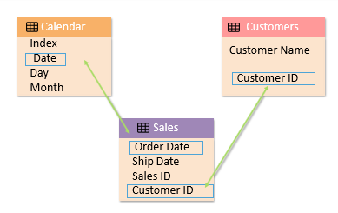
What are Relationships?
Relationships are used to join tables together so that we can work with them as if they are one
Relationships in Power Bl are much similar to the relationships we create in relational databases, such as Microsoft SQL Server, or data warehouse databases, such as SQL Server Analysis Services (SSAS)

Slide 5
What are Relationships?
Relationships in a relational database/OLTP, a data warehouse or Power Bl are a part of normalization
Benefits
Benefits of using relationships in a table are:
Establishes a Connection
It establishes a connection between a pair of tables that are logically related to each other.
Reduces Redundant data
It refines table structures and minimizes redundant data.

Slide 6
Creating Relationships

Slide 7
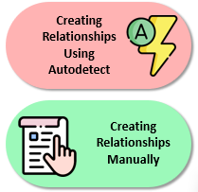
Creating Relationships
There are two ways of creating a relationship in Power Bl:
When data is imported into the model, Power Bl automatically creates relationships. If we then create calculated tables or use Enter Data to add new tables, relationships will not exist. However, Autodetect is the best guess, and it might need adjusting after it runs
The easiest way to create a relationship between two tables is to drag a column from the first table to the related column in the second table where we want to join. If the data is valid for creating a relationship, the columns will be connected.

Slide 8
Cardinality

Slide 9
Cardinality
In data modelling, cardinality refers to the relationship that one table has with another table
Different types of cardinality in Power 81 data modeling are :
One to One (1:1)
In a one-to-one relationship, both tables in the relationship have One instance Of the value.
One to Many(1:*)
This is the same as many to one, except that the position Of the tables is reversed in this relationship Type Types of Cardinality
Many to Many(*:*)
It eliminates the requirements for distinct values in tables. It eliminates prior workarounds, initiating new tables to Create Relationships.
Many to One (*:1)
Many to one means that one table can have more than one instance Of the value used in the column to join to the other table. The Other table would have value. This is the most used type in Power BI.

Slide 10
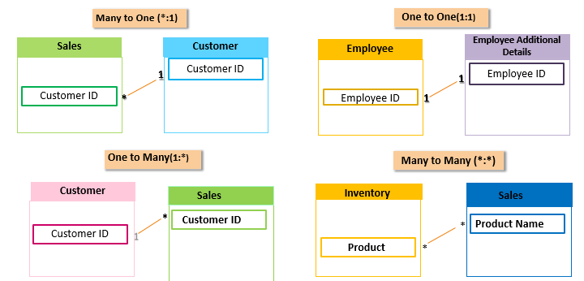
Cardinality

Slide 11
Cross Filter Direction

Slide 12
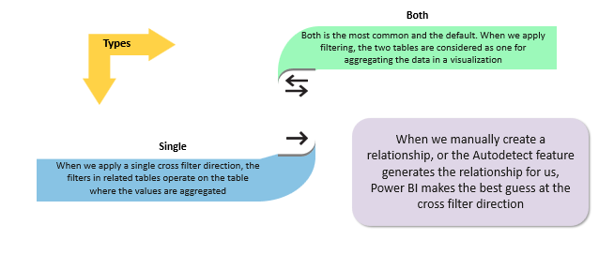
Cross Filter Direction
The cross filter direction of the relationships in our dataset decides how Power BI has to treat the
tables in visualizations in our reports

Slide 13
Demo: Working with Relationships

Slide 14
What is DAX?

Slide 15
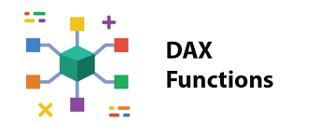
What is DAX?
Data Analysis Expressions (DAX) is a formula language that consists of a library of more than 250+ functions, constants, and operators.
DAX is used in a formula or expression to calculate and return a single value or multiple values.
DAX is not a new feature. It is used in Power Pivot for Excel or SQL Server Analysis Services (SSAS).

Slide 16
Why Dax?
Using DAX in a effective way will help us get the most of our data.
Measures created using DAX help us solve real world problems easily.
DAX helps us perform calculations over large data easily to get valuable insights to make it more Useful.

Slide 17
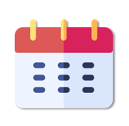
Why Dax?
DAX helps us find the insights that we want to extract from our data to make it more useful.
For example, suppose we want to compare the sales of this year so far, like-for-like with the last year. If the current month is May, we only want to compare till May of the previous year.
Last Year Sales = CALCULATE ([Total Sales], SAMEPERlODLASTYEAR(‘Date’l[Datel))

Slide 18
DAX Syntax.

Slide 19
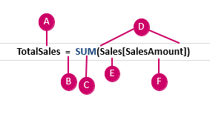
DAX Syntax.
The key for understanding and using DAX is learning the syntax for structuring formulas, the functions
that we use to make calculations, and the context.
DAX formula syntax includes various elements that make up a formula.
A. The measure name
B. The equal sign operator, which indicates the beginning of the
formula
C. The DAX function, SUM
D. Parentheses(), which surround an expression that contains one
or more arguments
E. The referenced table (Sales)
F. The referenced column (SalesAmount) in the referenced table

Slide 20
DAX Functions

Slide 21

DAX Functions
DAX functions are predefined formulas that perform calculations on one or more arguments.
We can pass a column, function, expressions, formulas, constants, numbers, text, and TRUE or FALSE as an argument.
DAX is similar to Excel, but DAX refers to an entire column or a table. We can filter to refer to a particular value.

Slide 22
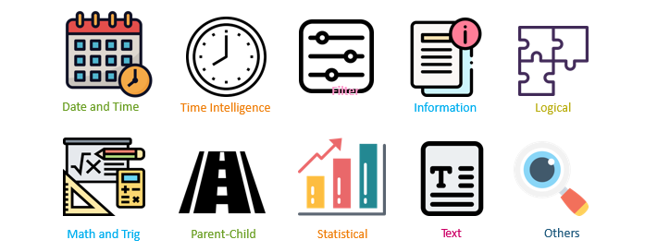
DAX Functions
The DAX library of more than 200 functions, operators, and constructs is segmented into the following
10 categories:

Slide 23
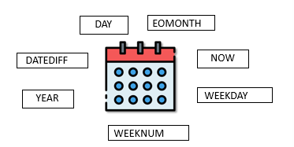
DAX Functions
Date and Time
Time Intelligence
Filter
Information
Logical
Math and Trigonometric
Parent-Child
Statistical
Text
Others
The Date and Time DAX function is similar to the date and
time functions used in Excel, but it is based on the datetime
data types used by Microsoft SQL Server

Slide 24
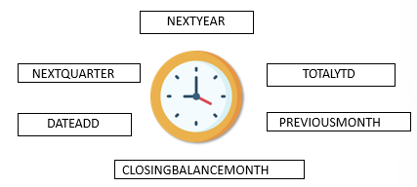
DAX Functions
Date and Time
Time Intelligence
Filter
Information
Logical
Math and Trigonometric
Parent-Child
Statistical
Text
Others
Using Time Intelligence functions, we can create date and time ranges combined with aggregations, and it is useful for building comparisons across time periods.

Slide 25
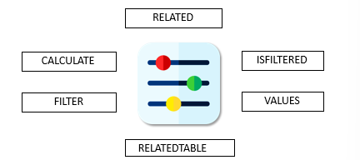
DAX Functions
Date and Time
Time Intelligence
Filter
Information
Logical
Math and Trigonometric
Parent-Child
Statistical
Text
Others
Using Filter functions, we can get specific data types, look
up values in related tables, or filter by related values

Slide 26
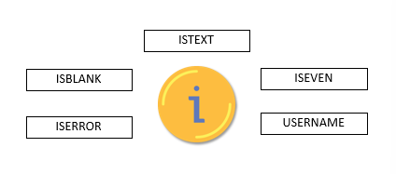
DAX Functions
Date and Time
Time Intelligence
Filter
Information
Logical
Math and Trigonometric
Parent-Child
Statistical
Text
Others
Information functions evaluate a table or a column
provided as an argument to another function and inform us
if the value matches the expected type

Slide 27
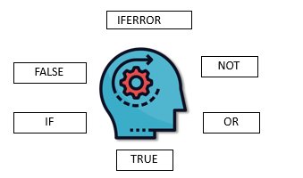
DAX Functions
Date and Time
Time Intelligence
Filter
Information
Logical
Math and Trigonometric
Parent-Child
Statistical
Text
Others
The Logical function returns information about the value in
our expression

Slide 28
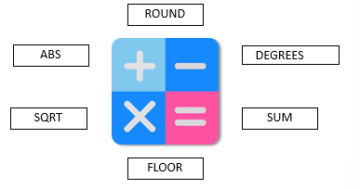
DAX Functions
Date and Time
Time Intelligence
Filter
Information
Logical
Math and Trigonometric
Parent-Child
Statistical
Text
Others
The Math and Trig functions perform a wide variety of
mathematical calculations, and they are similar to the
mathematical and trigonometrical functions in Excel

Slide 29
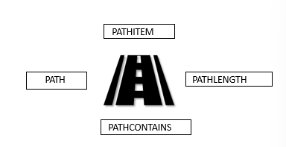
DAX Functions
Date and Time
Time Intelligence
Filter
Information
Logical
Math and Trigonometric
Parent-Child
Statistical
Text
Others
The Parent-Child functions work on the data that is
presented in a parent/child hierarchy in the data model

Slide 30
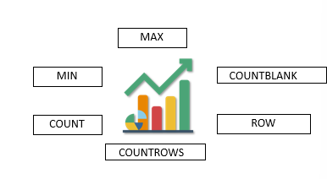
DAX Functions
Date and Time
Time Intelligence
Filter
Information
Logical
Math and Trigonometric
Parent-Child
Statistical
Text
Others
Statistical functions are used to perform aggregations, and
we can filter a column prior to aggregations

Slide 31
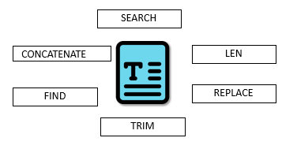
DAX Functions
Date and Time
Time Intelligence
Filter
Information
Logical
Math and Trigonometric
Parent-Child
Statistical
Text
Others
Text functions operate on string values. We can use Text
functions for searching a text within a string, returning a
substring, formatting dates, times, and numbers, and
concatenating strings

Slide 32
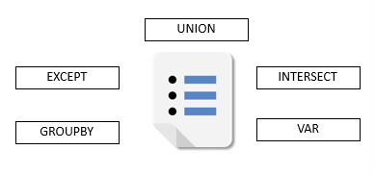
DAX Functions
Date and Time
Time Intelligence
Filter
Information
Logical
Math and Trigonometric
Parent-Child
Statistical
Text
Others
These are some unique functions that do not fall into any of
the other categories

Slide 33
Context in DAX

Slide 34
Context in DAX
Context is an important concept to understand if we want to write expressions that return the results we expect
Types
Row Context
A row context is a formula that includes function that filters to identify single row in a table. The function applies a row context to each Row in the table to which the filter is applied
Filter Context
A filter context is one or more filters applied in a calculation, which determine single value or the result. We can use a filter context to reduce the values that are included in a calculation

Slide 35
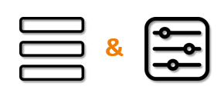
Context in DAX
The following measure demonstrates how a row context and a filter context operate on a
calculation in the formula
Using Row Context and Fitter Context in a Measure
UK Sales = CALCULATE(Total Sales], Customers[Country] = “UK")
This formula uses Total Sales and applies a filter of UK so that only the sum of UK Sales will be
returned in the result

Slide 36
Demo: Using Row Context and Filter Context

Slide 37
Calculated Columns

Slide 38
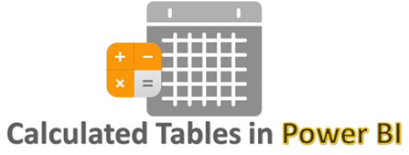
Calculated Columns
Calculated columns are added to tables by applying DAX formulas to the existing data.
The DAX formula defines the values in the new column rather than querying the data source to create the column.
We can create calculated columns by concatenating strings or multiple numbers together, combining the data from anywhere in the model.
Calculated columns are similar to measures, but the difference lies in how they are used. Measures are used in the Values area of a visualization, and Calculated columns are used in the Axis, Legend, or Group fields

Slide 39
Calculated Columns
There are two ways in which we can create calculated columns in a data model
This code does not include table names since the columns exist within the same table, but it is a good practice to include the table name for clarity Full Name [First Name] & " " & [Last Name]
If we refer to a column in another table, then we must include the table name using the Related function Location = RELATED(Countries[Region]) & " & [City]
Creating a calculated column using the existing data
Creating a calculated column using the Related function

Slide 40
Calculated Tables

Slide 41
Calculated Tables
Like calculated columns, calculated tables are also created using the data that already exists in the model, which uses a DAX formula to define the values.
Calculated tables are created in both the Report view and the Data view in Power Bl Desktop.
1. Combine the existing table using UNION
2. Create a calculated table using NATURAL INNERJOIN
3. Great a calculated tabi; using the DATATABLE function

Slide 42
Measures

Slide 43
Measures
1. Power Bl measures help us discover insights into our data that might otherwise be hidden
2. Measures use aggregating functions such as average, minimum, maximum, count distinct, or more complex calculations that use a DAX function
3. Measures are created using DAX formulas and with an extensive library of functions, operators, and constructs

Slide 44
Demo: Using Calculated Columns and Measures

Slide 45
Connect with me

